Slide 1

Fitness tracker
By
K Sai siddhartha (AP23110010560)
T .Nandan(AP23110010526)
P .Hemanth patel(AP23110010559)
V .karthikeya(AP23110010533)

Slide 2
introduction
The Fitness Tracker is a software application designed to assist users in monitoring and improving their health and fitness goals. This project leverages the powerful features of C++ to implement an efficient and user-friendly system for tracking physical activities, calorie intake, workout sessions, and other health metrics. The primary objective is to encourage a healthy lifestyle by providing users with actionable insights into their daily routines and progress.

Slide 3
Key features
Activity Tracking: Logs details of physical activities, including type, duration, and calories burned.
Diet Monitoring: Tracks daily calorie intake and provides nutritional feedback.
Progress Visualization: Displays data trends, such as weight changes and activity levels, using textual or graphical outputs.
Goal Setting: Allows users to set fitness goals like weight loss, step count, or workout hours, and monitors their progress.
Customizability: Adapts to individual user needs, offering customizable fitness plans.

Slide 4
Input Main Menu Selection Choose between: 1 (Log in) 2 (Create profile) 3 (Display summaries) 4 (Exit) Username Input Provide a username (e.g., JohnDoe). Exercise Selection Pick an exercise from a list of predefined exercises (1–15). Exercise Duration Enter the duration for the selected exercise (positive number). Set Exercise Goal Provide: Goal type (e.g., "Daily"). Target duration (e.g., 60 minutes). Timeframe (e.g., "week"). Save Data Optionally save exercise data to a file.
Output
1.Main Menu Selection
Proceed to the chosen action or display an error for invalid input.
Username Input
For Existing User: "Logged in as [username]."
For New User: "New profile created for [username]."
For Invalid Input: "Invalid username."
Exercise Selection
For Valid Input: Proceeds to duration entry.
For Invalid Input: "Invalid exercise selection. Please choose a number between 1 and 15."
Exercise Duration
For Valid Input: Logs the exercise and displays the calories burned.
For Invalid Input: "Invalid input. Please enter a positive number for duration."
View Summary
Displays all logged exercises, total duration, calories burned, and the exercise goal.
Set Exercise Goal
Confirmation message: "Exercise goal set: [target] minutes per [timeframe]."
Save Data
"Data saved to file."
Error if save fails: "Failed to save data to file."

Slide 5
User class attributes…
1. static const int MAX_EXERCISES
- Maximum number of exercises that can be stored.
2. string username
- Stores the username of the user.
3. Exercise exercises[MAX_EXERCISES]
- Array of `Exercise` objects to hold all logged exercises.
4. int exerciseCount
- Number of exercises currently logged.
5. int totalDuration
- Total duration of all exercises in minutes.
6. double totalCaloriesBurned
- Total calories burned from all exercises.
7. ExerciseGoal exerciseGoal
- Stores the exercise goal for the user.

Slide 6
Advantages of Fitness Tracker as a C++ Project
Object-Oriented Design
Utilizes classes like Exercise, UserProfile, and FitnessTracker to model real-world entities, promoting modularity and code reuse.
Namespace Usage
Encapsulates all related functionality within the FitnessTracker namespace, avoiding name conflicts and improving organization.
Scalability
Supports multiple users and exercises, making it easy to expand with additional features like new exercises or advanced analytics.
Data Persistence
Saves user data to files, ensuring data is not lost between program runs and can be analyzed later.
Customizability
Allows predefined exercises and their calorie burn rates to be updated easily, accommodating various fitness regimens.

Slide 7
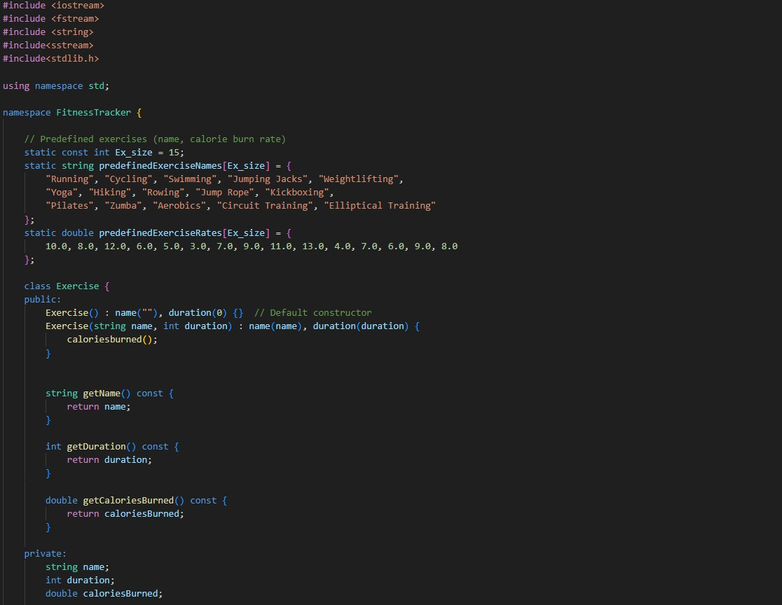

Slide 8
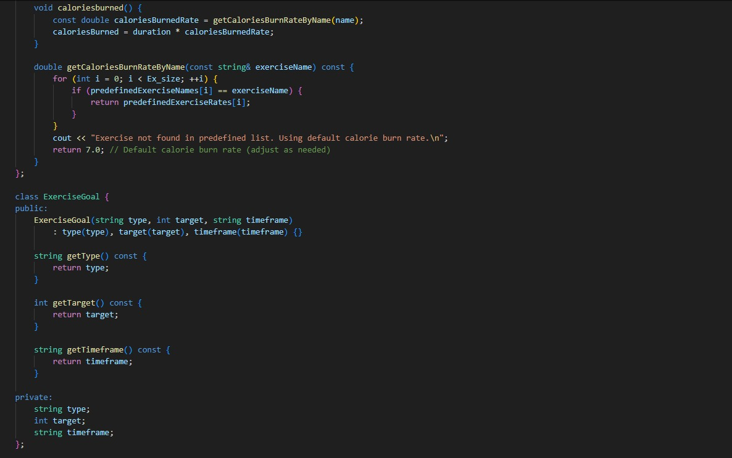

Slide 9
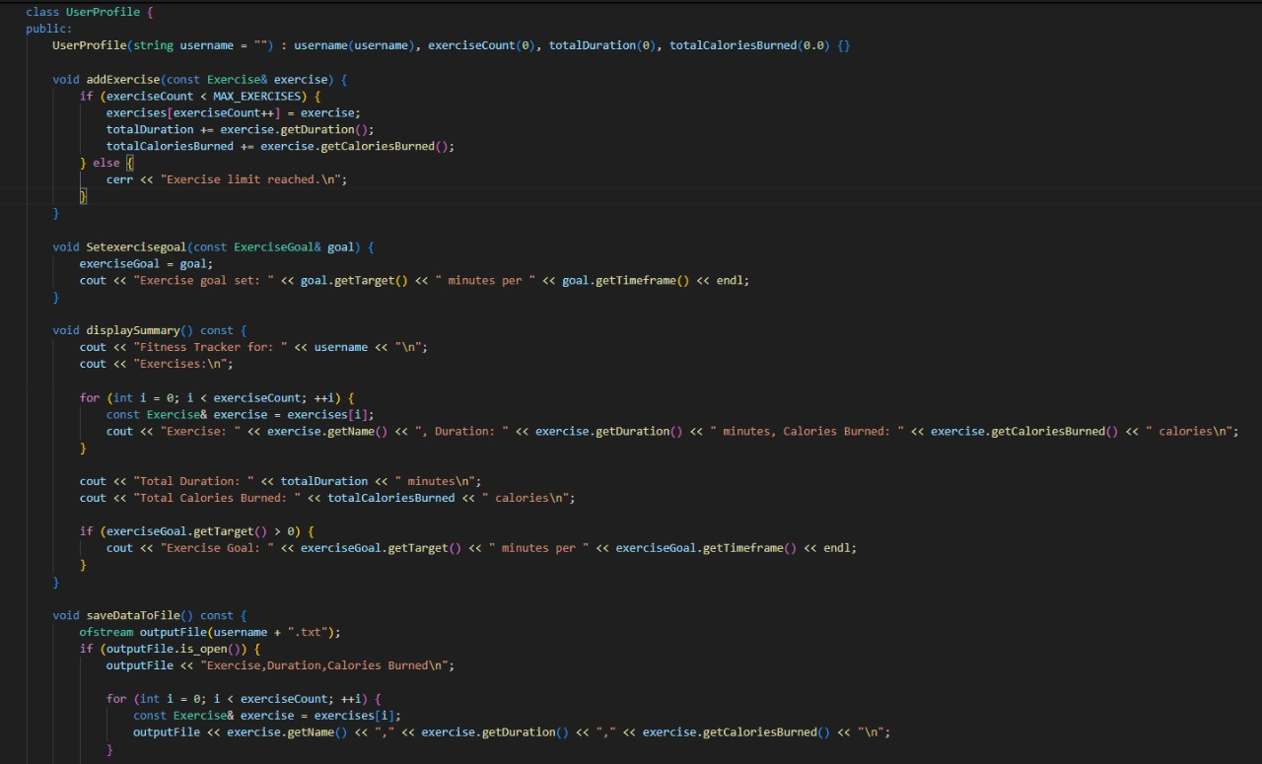

Slide 10
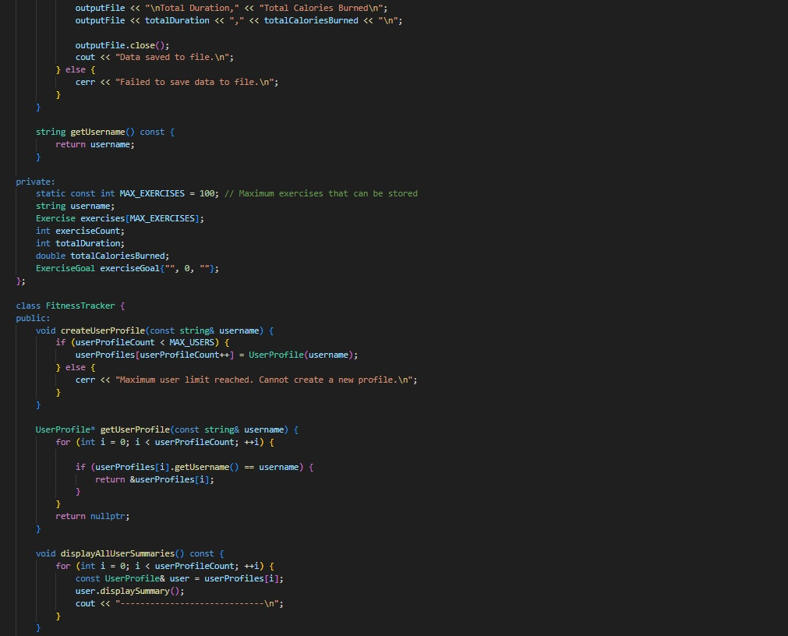

Slide 11
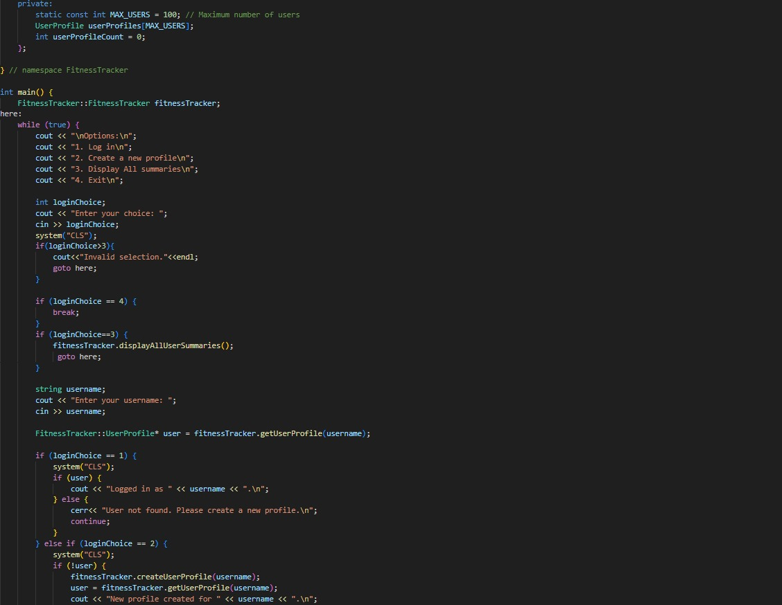

Slide 12
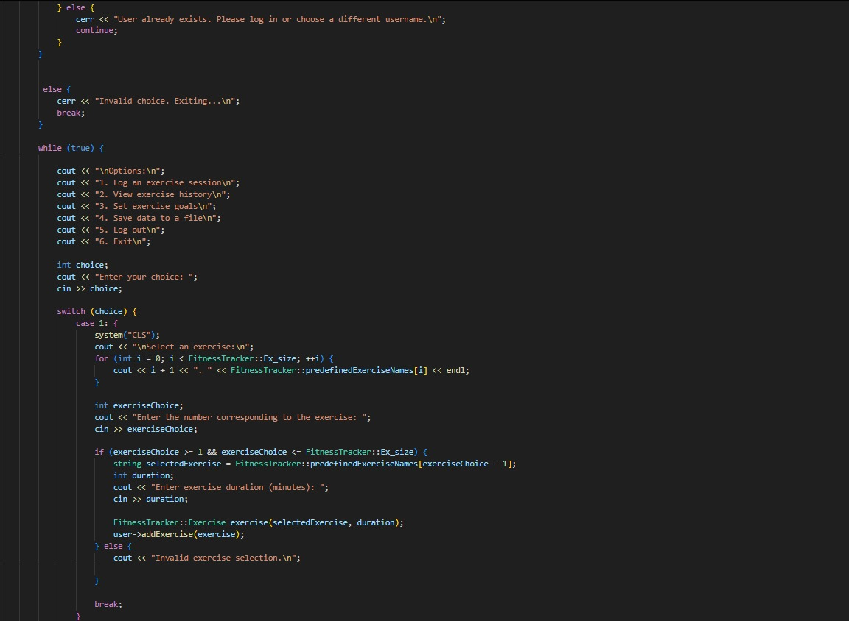

Slide 13
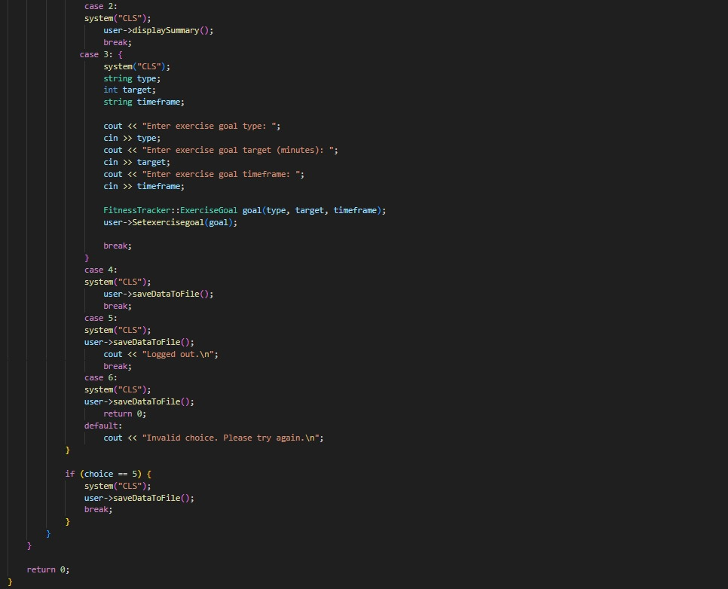

Slide 14
Conclusion: The Fitness Tracker project developed in C++ effectively demonstrates the ability to manage and analyze fitness data efficiently. By leveraging object-oriented programming principles, the application provides users with essential features like tracking daily activities, monitoring calories burned, and setting fitness goals. The project highlights the importance of structuring data using classes and methods, ensuring scalability and maintainability. It also showcases the integration of simple algorithms for calculating metrics, making it a practical tool for personal health monitoring. Through this project, we gained valuable insights into program design, data handling, and problem-solving in C++. With further enhancements, such as adding database support and real-time analytics, the application can evolve into a comprehensive fitness management tool.

Slide 15
Cout<<“thank youuu”;
stay fit guyss

